Slide 2
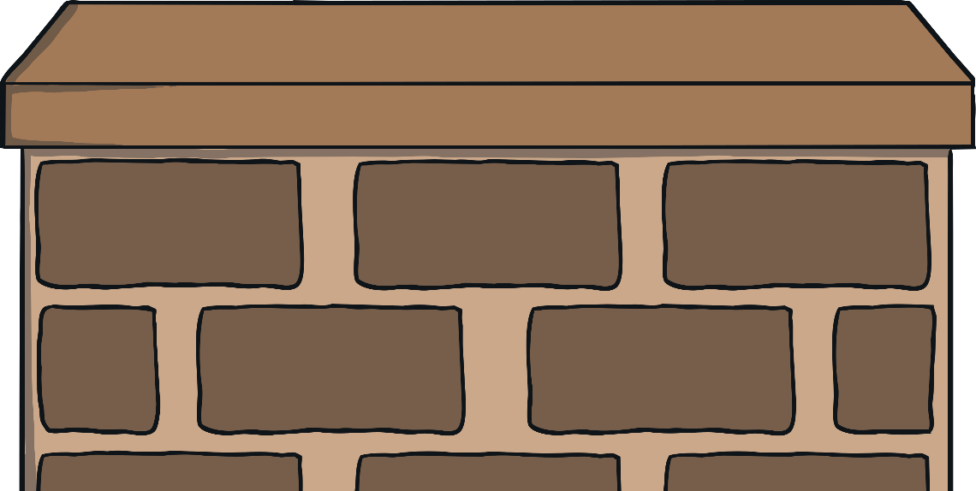
Five green bottles standing on the wall,
Five green bottles standing on the wall,
And if zero green bottles should accidentally fall,
There’ll be five green bottles standing on the wall.
5
+
0
=
5

Slide 3
5
5
+
0
=
5

Slide 4
Five green bottles standing on the wall,
Five green bottles standing on the wall,
And if one green bottle should accidentally fall,
There’ll be four green bottles standing on the wall.
4
+
1
=
5

Slide 5
5
4
+
1
=
5

Slide 6
Five green bottles standing on the wall,
Five green bottles standing on the wall,
And if two green bottles should accidentally fall,
There’ll be three green bottles standing on the wall.
3
+
2
=
5

Slide 7
5
3
+
2
=
5

Slide 8
Five green bottles standing on the wall,
Five green bottles standing on the wall,
And if three green bottles should accidentally fall,
There’ll be two green bottles standing on the wall.
2
+
3
=
5

Slide 9
5
2
+
3
=
5

Slide 10
Five green bottles standing on the wall,
Five green bottles standing on the wall,
And if four green bottles should accidentally fall,
There’ll be one green bottle standing on the wall.
1
+
4
=
5

Slide 11
5
1
+
4
=
5

Slide 12
Five green bottles standing on the wall,
Five green bottles standing on the wall,
And if five green bottles should accidentally fall,
There’ll be zero green bottles standing on the wall.
0
+
5
=
5

Slide 13
5
0
+
5
=
5

Slide 14
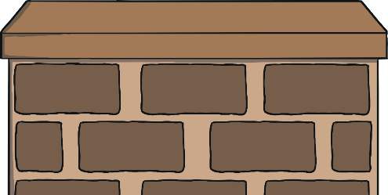
Can you complete the number bonds?
1
+
4
=
5
3
+
2
=
5
5
+
0
=
5
2
+
3
=
5

